Slide 1
Data Visualization & Exploratory Data Analysis

Slide 2
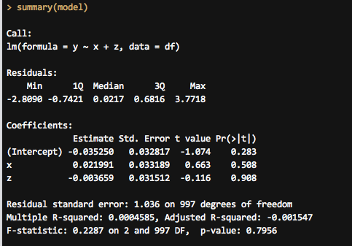
Statistics can be ugly
Why? | Univariate | Multivariate | Models | How?

Slide 3
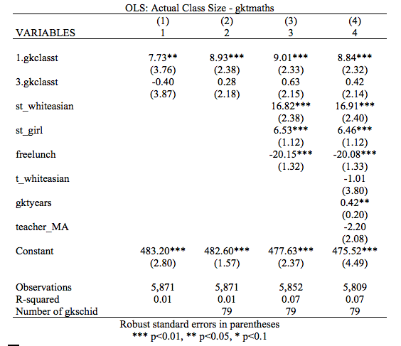
Numbers are scary
Why? | Univariate | Multivariate | Models | How?
Notes:
How many of you read an article with regression coefficients in it in the past few days? Can you tell me what one of those coefficients was?

Slide 4
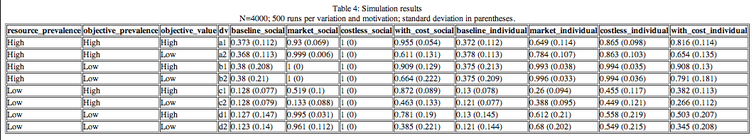
Walls of numbers
Why? | Univariate | Multivariate | Models | How?

Slide 5
Exploratory Data Analysis
“Interocular traumatic impact”
Enhance probabilistic analysis
Check shape and assumptions
Why? | Univariate | Multivariate | Models | How?
Notes:
John Tukey, William S. Cleveland, Joseph Berkson – “Sometimes visualization can fully replace the need for probabilistic inference. We visualize the data effectively and suddenly, there is what Joseph Berkson called interocular traumatic impact: a conclusion that hits us between the two eyes” (via http://development.thinkingwithdata.com/show.php?p=workshop.html)

Slide 6
Right between the eyes…
Why? | Univariate | Multivariate | Models | How?

Slide 7
Right between the eyes…
Why? | Univariate | Multivariate | Models | How?

Slide 8
Right between the eyes…
Why? | Univariate | Multivariate | Models | How?

Slide 9
Understand your data
Visualize every variable individually
Visualize relationships between variables
Visualize models
Why? | Univariate | Multivariate | Models | How?
Notes:
Before you run any models, check all the variables you’re using

Slide 10
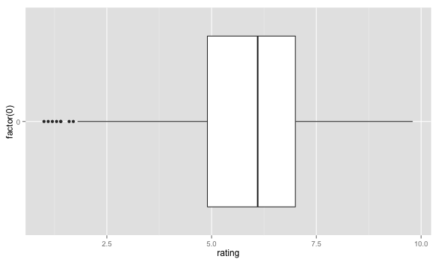
Boxplots
Univariate visualization
Continuous data
graph box variable
Why? | Univariate | Multivariate | Models | How?
Notes:
Shows important parts of the 5-number summary – quartiles + median + outliers (1.5 IQR, 1st–3rd quartiles)

Slide 11
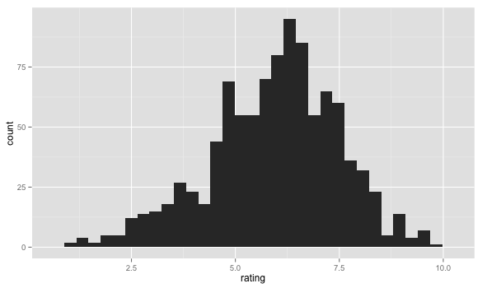
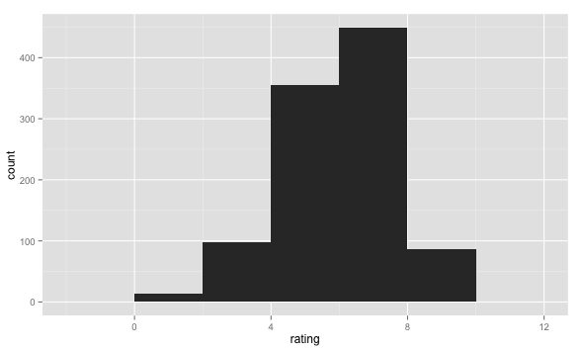
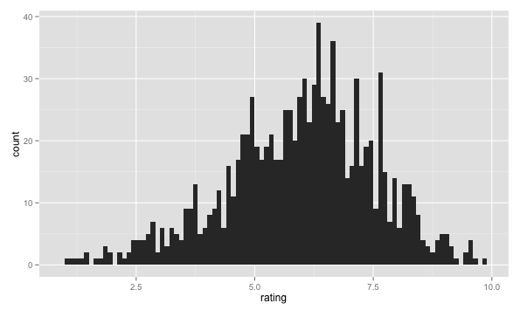
Histograms
Univariate visualization
Continuous data
histogram variable
Why? | Univariate | Multivariate | Models | How?
Notes:
Sticks things in bins, but is dependent on the number of bins

Slide 12
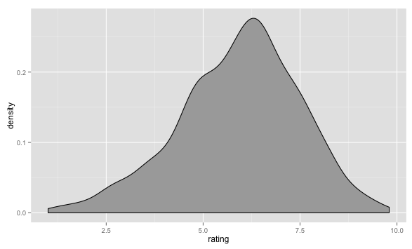
Density plots
Univariate visualization
Continuous data
kdensity variable
Why? | Univariate | Multivariate | Models | How?
Notes:
Better, shows a kernel density estimate of the data – better for seeing the actual distribution – best for continuous data

Slide 13
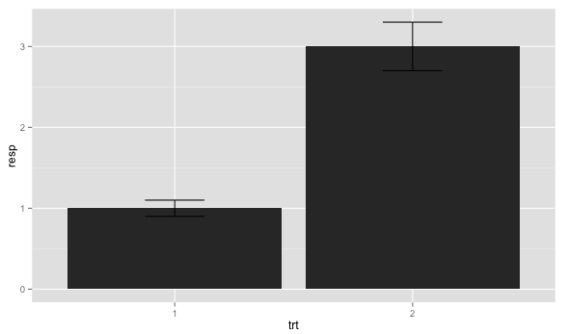
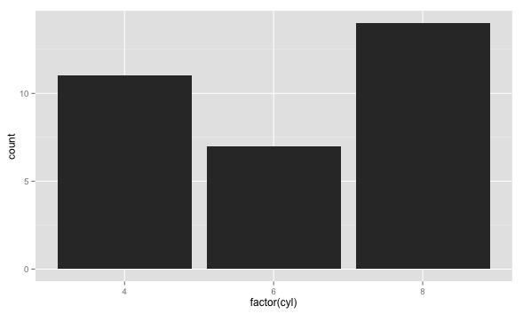
Bar charts
Univariate visualization
Categorical data
Why? | Univariate | Multivariate | Models | How?
Notes:
Bar charts – must start at 0, must not be connected (otherwise it’s a histogram) – good for categorical data

Slide 14
Bivariate visualization
 | Continuous | Categorical
Continuous | Scatterplots | Grouped plots
Categorical | — | Mosaic plots, grouped plots
Pack in as much data as you can
Why? | Univariate | Multivariate | Models | How?

Slide 15
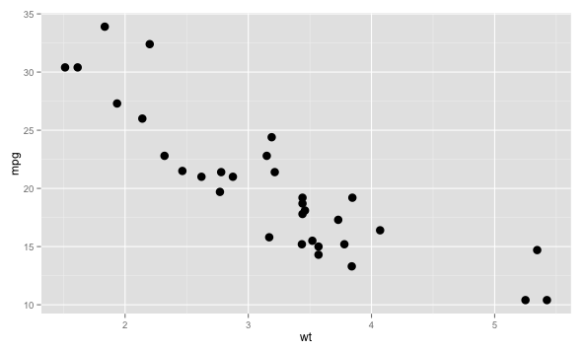
Scatterplots
Bivariate visualization
Continuous + continuous
Why? | Univariate | Multivariate | Models | How?
Notes:
Standard visualization

Slide 16
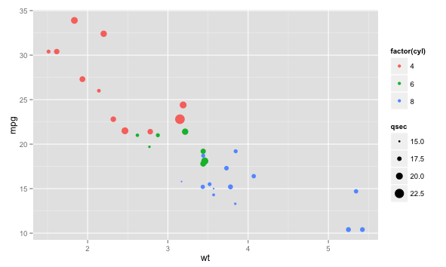
MOAR DATA!!1!
Bivariate visualization
Continuous + continuous
Why? | Univariate | Multivariate | Models | How?
Notes:
Add other parts of your data to get a better understanding of what’s going on
qsec = ¼ mile time

Slide 17
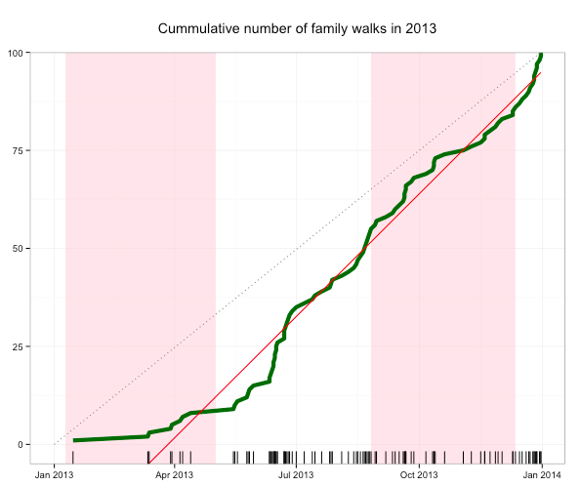
Lines
Bivariate visualization
Continuous + continuous
Why? | Univariate | Multivariate | Models | How?
Notes:
Add other parts of your data to get a better understanding of what’s going on
qsec = ¼ mile time

Slide 18
Filled lines
Bivariate visualization
Continuous + continuous
Why? | Univariate | Multivariate | Models | How?

Slide 19
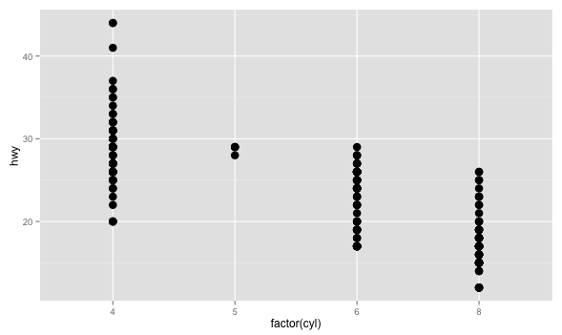
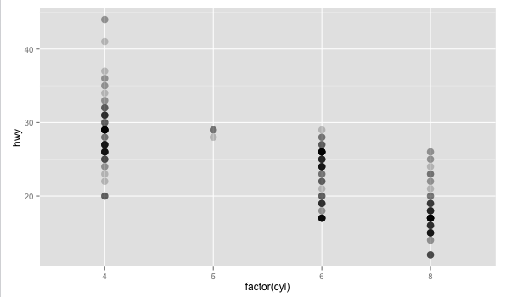
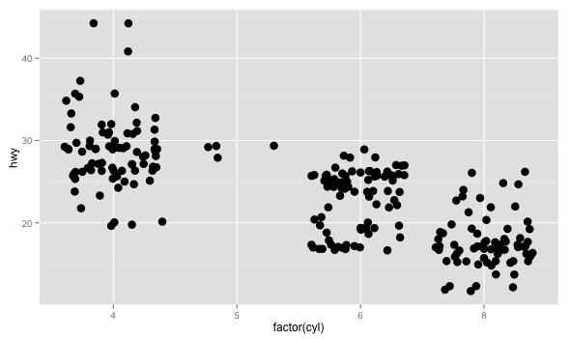
Grouped points
Bivariate visualization
Continuous + categorical
Why? | Univariate | Multivariate | Models | How?
Notes:
Add other parts of your data to get a better understanding of what’s going on – better than bar charts, since you can see all the data (bars hide the distribution)

Slide 20
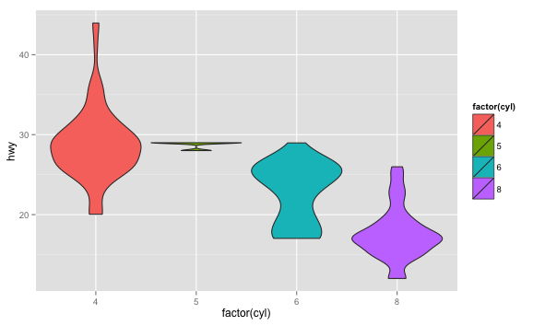
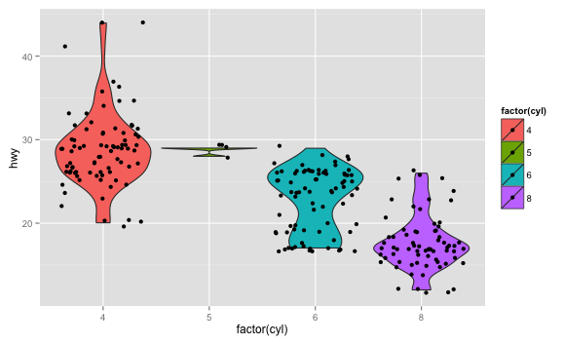
Violin plots
Bivariate visualization
Continuous + categorical
Why? | Univariate | Multivariate | Models | How?

Slide 21
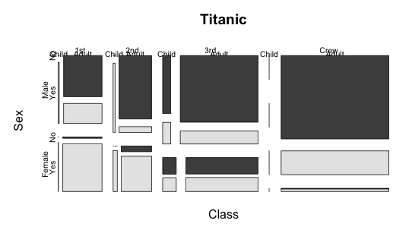
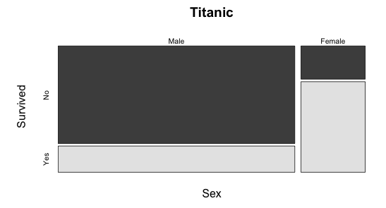
Mosaic plots
Bivariate visualization
Categorical + categorical
Why? | Univariate | Multivariate | Models | How?

Slide 22
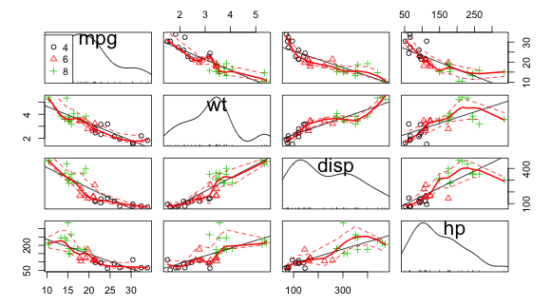
Scatterplot matrices
Model diagnostics
Regression
Why? | Univariate | Multivariate | Models | How?
Notes:
For collinearity

Slide 23
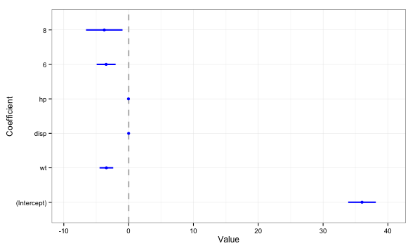
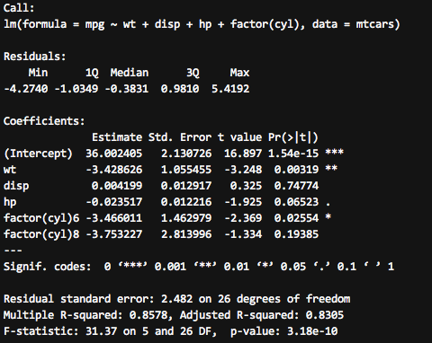
Coefficient plots
Model visualization
Regression
Why? | Univariate | Multivariate | Models | How?

Slide 24
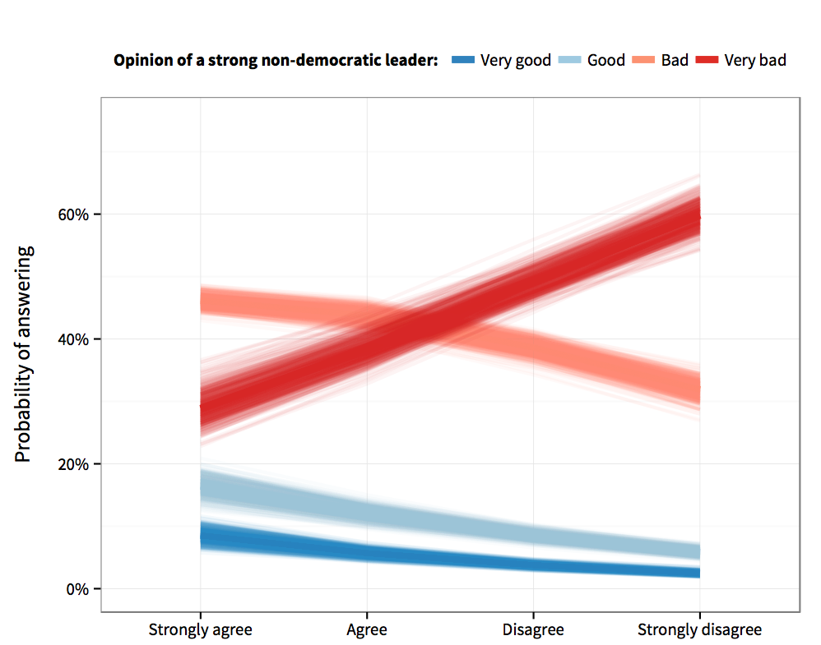
Predicted probabilities
Model visualization
Logit/Ologit
Why? | Univariate | Multivariate | Models | How?
Notes:
Nobody understands odds ratios. Convert them to predicted probabilities and plot them

Slide 25
Other models
Diff-in-diff (link to file)
Regression discontinuity (link to file)
Why? | Univariate | Multivariate | Models | How?
Notes:
Show stuff from PDFs?

Slide 26
How do I do all this?
Stata
sysuse auto
graph box mpg, by(rep78, cols(2))
install ssc vioplot
vioplot mpg, over(rep78) horizontal
install ssc catplot
catplot rep78, by(foreign) percent(foreign)
R + ggplot2
Why? | Univariate | Multivariate | Models | How?
Notes:
Stata menus are incredibly useful and contain pretty much every option you need to graph 80%ish of the stuff here.
But Stata is not the greatest thing out there for graphics – it’s been discussed on their mailing lists
R produces publication-worthy graphics, especially with the ggplot2 package – based on the Grammar of Graphics, lets you add layers of data, get really dense, beautiful plots
R is another statistical programming language, but it’s fairly intuitive (and free and open source!). Plus you can technically do all your data cleaning and analysis in Stata and then just graph stuff in R – you just have to learn the basics of ggplot to get things working

Slide 27
How do I do all this?
Ask for help!
Why? | Univariate | Multivariate | Models | How?
Notes:
Stata menus are incredibly useful and contain pretty much every option you need to graph 80%ish of the stuff here.
But Stata is not the greatest thing out there for graphics – it’s been discussed on their mailing lists
R produces publication-worthy graphics, especially with the ggplot2 package – based on the Grammar of Graphics, lets you add layers of data, get really dense, beautiful plots
R is another statistical programming language, but it’s fairly intuitive (and free and open source!). Plus you can technically do all your data cleaning and analysis in Stata and then just graph stuff in R – you just have to learn the basics of ggplot to get things working

Slide 28
Go make pretty pictures.

